Slide 1

EMR Cluster Creation
Saravanan Prabhagaran
Sr. Solutions Architect Database & Analytics
12/11/19
Updated: 25-June-2018

Slide 2


Creation options
AWS
Management
Console
AWS CLI
AWS
SDKs

Slide 3
CLI
aws emr create-cluster
--release-label emr-5.14.0
--instance-groups InstanceGroupType=MASTER,InstanceCount=1,InstanceType=m3.xlarge InstanceGroupType=CORE,InstanceCount=2,InstanceType=m3.xlarge

Slide 4
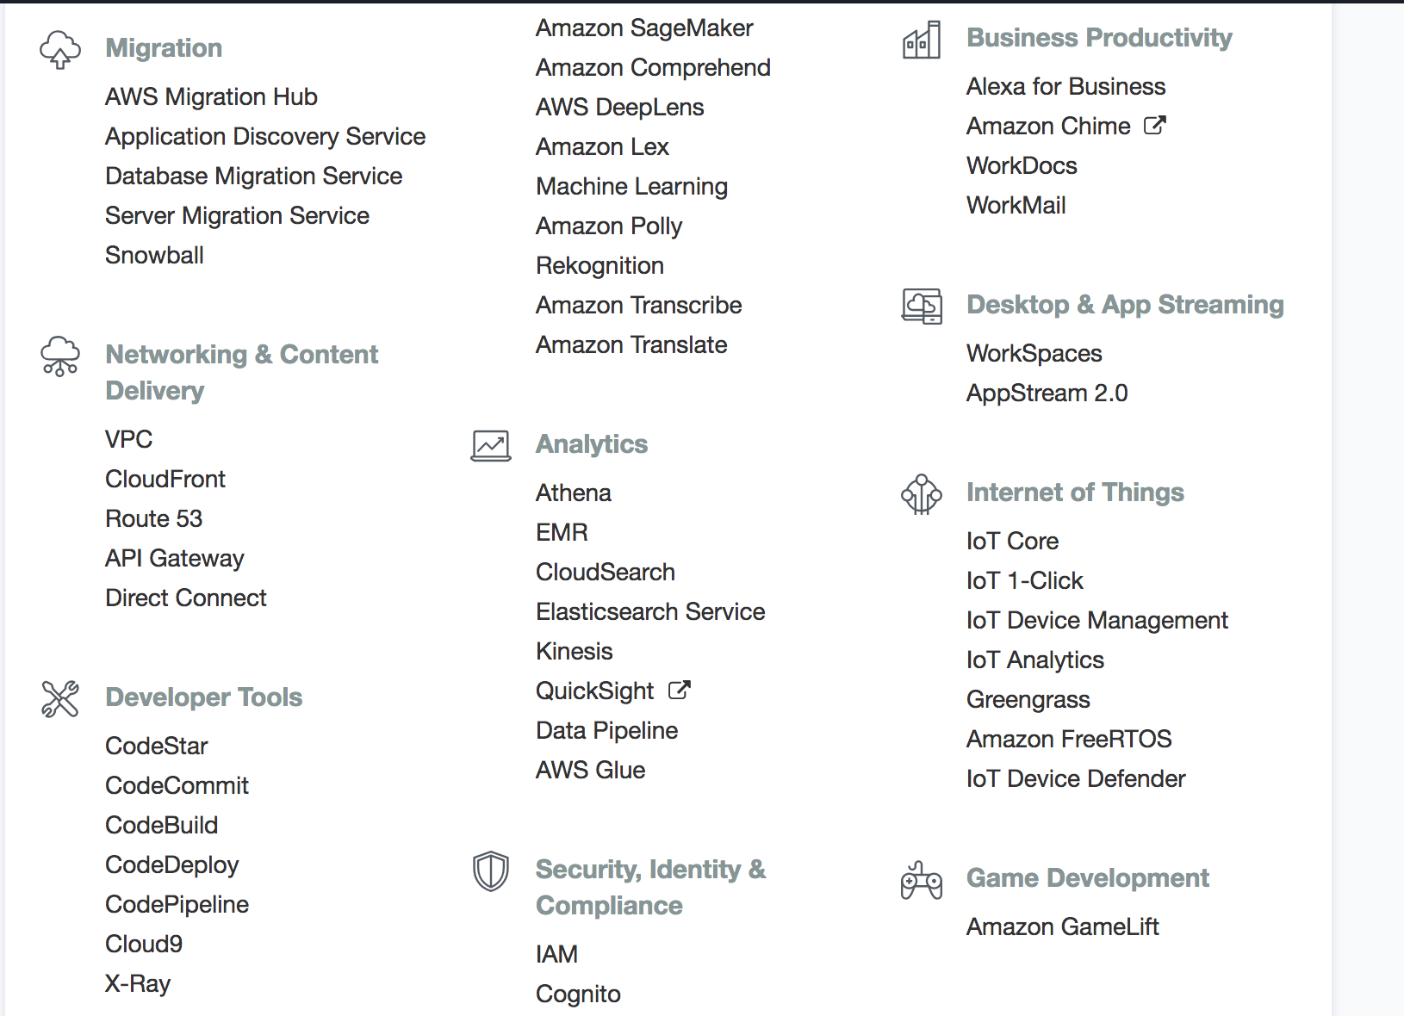


Slide 5
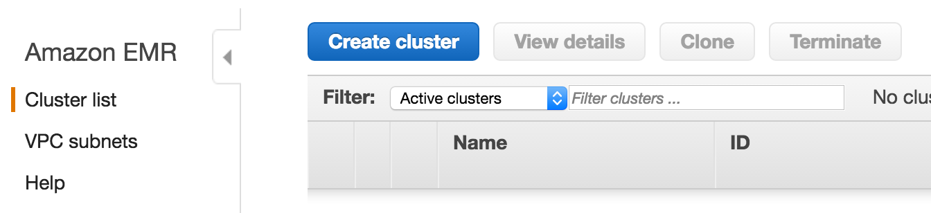
Create Cluster - Console

Slide 6
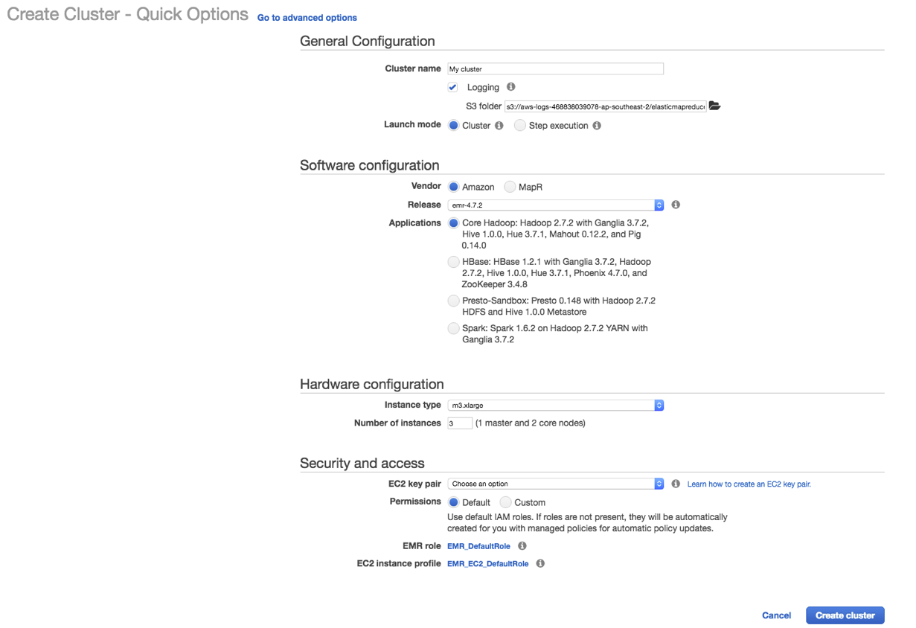
Advanced Options
Quick Create

Slide 7
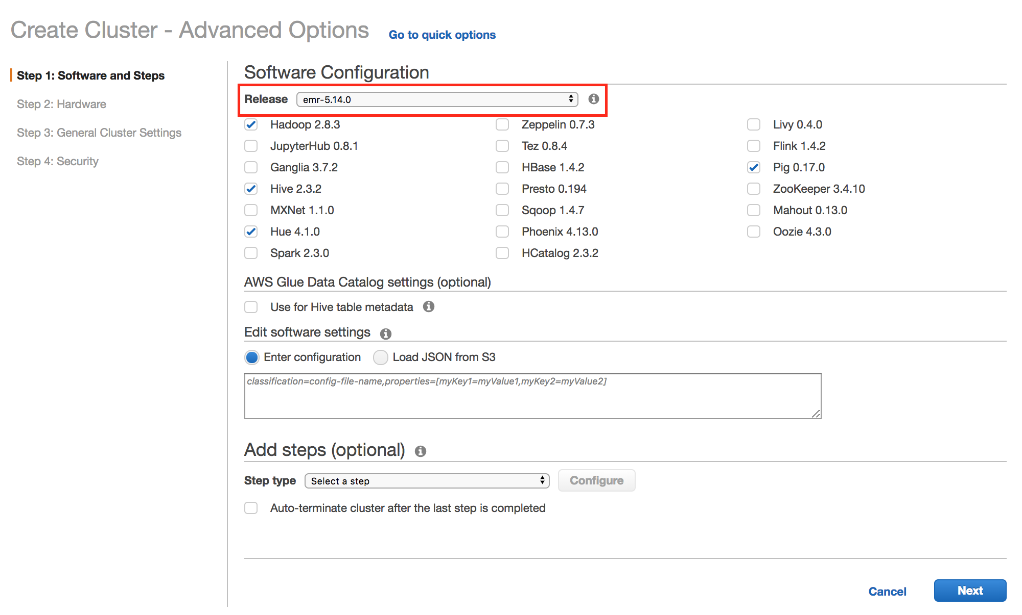

Slide 8
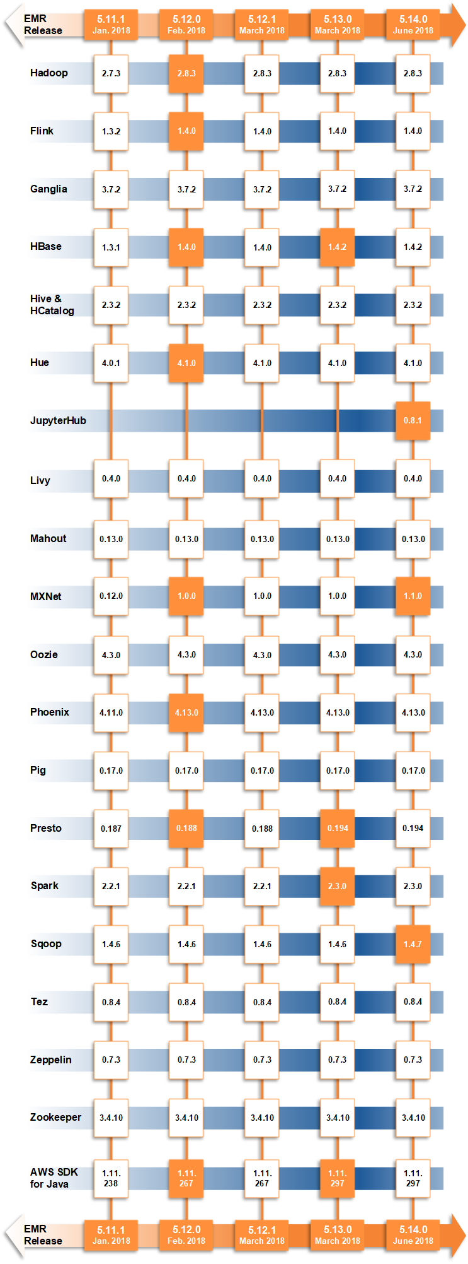
















Slide 9
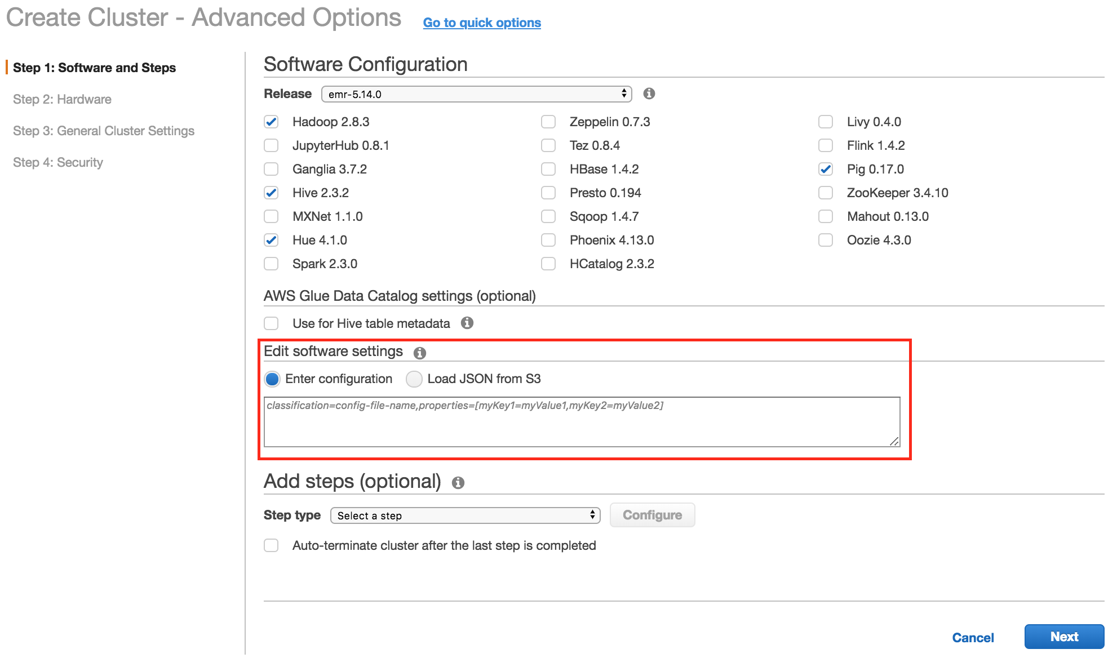

Slide 10
Edit Software Settings
Overide default configurations
Inline or JSON
capacity-scheduler, core-site, hadoop-env, hadoop-log4j, hdfs-site, httpfs-env, https-site, mapred-env, mapred-site, yarn-env, yarn-site, hive-env, hive-exec-log4j, hive-log4j, hive-site, pig-properties, pig-log4j etc.
Notes:
You can override the default configurations for applications you install by supplying a configuration object when specifying applications you want installed at cluster creation time. Configuration objects consist of a classification, properties, and optional nested configurations. A classification refers to an application-specific configuration file. Properties are the settings you want to change in that file. You typically supply configurations in a list, allowing you to edit multiple configuration files in one JSON list.

Slide 11
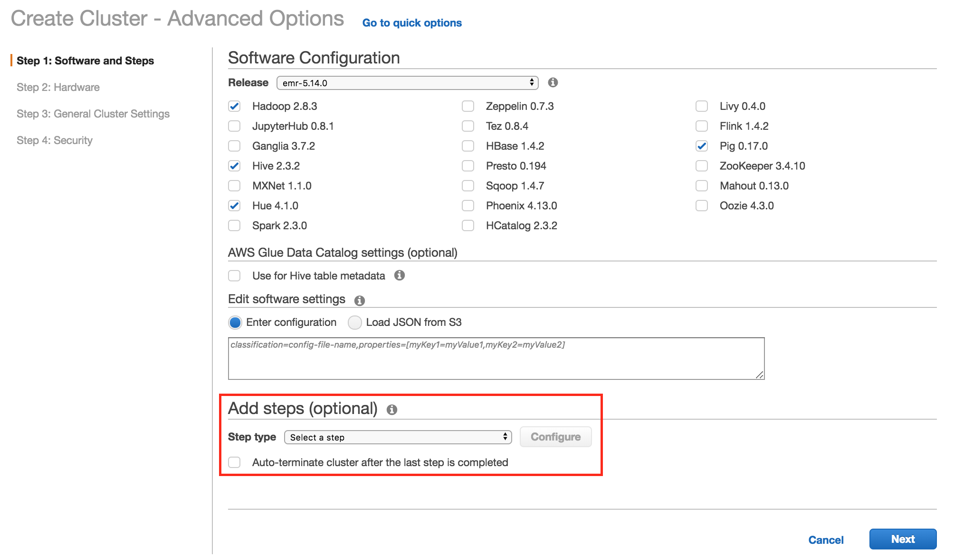

Slide 12
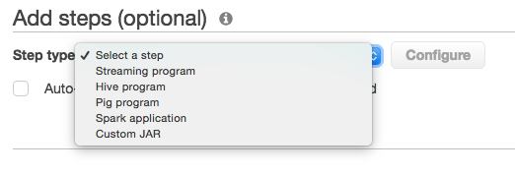
Add steps
A step is a unit of work you submit to the cluster
Auto-terminate cluster or leave running
Streaming program for executable other than Java

Slide 13
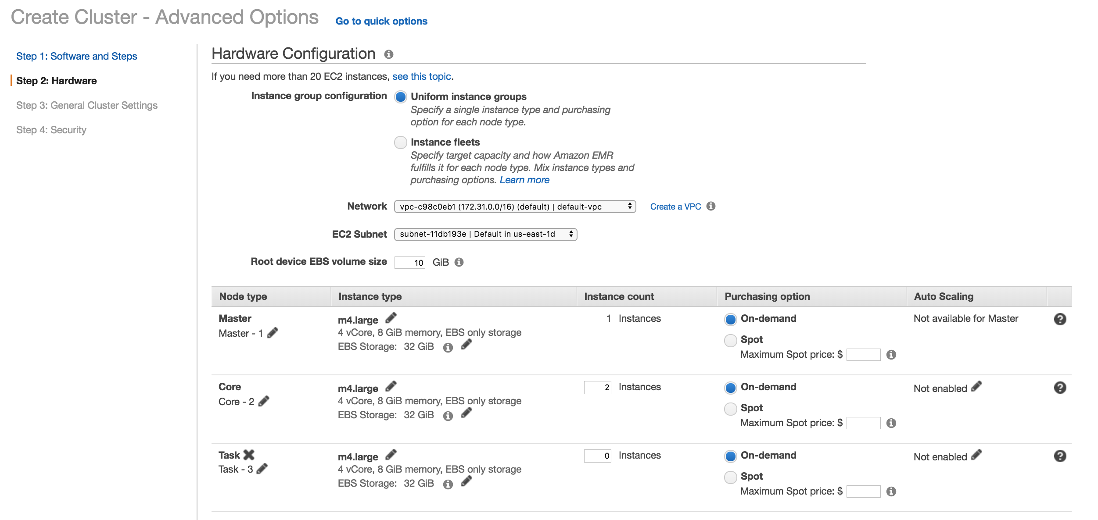
Hardware Configuration

Slide 14
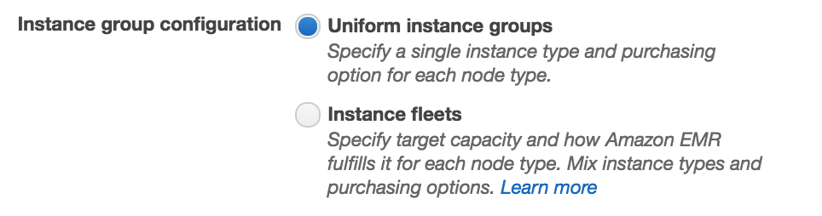
Instance group configuration – Instance fleets
Provision from a list of instance types with Spot and On-Demand
Launch in the most optimal Availability Zone based on capacity/price
Spot Block support

Slide 15
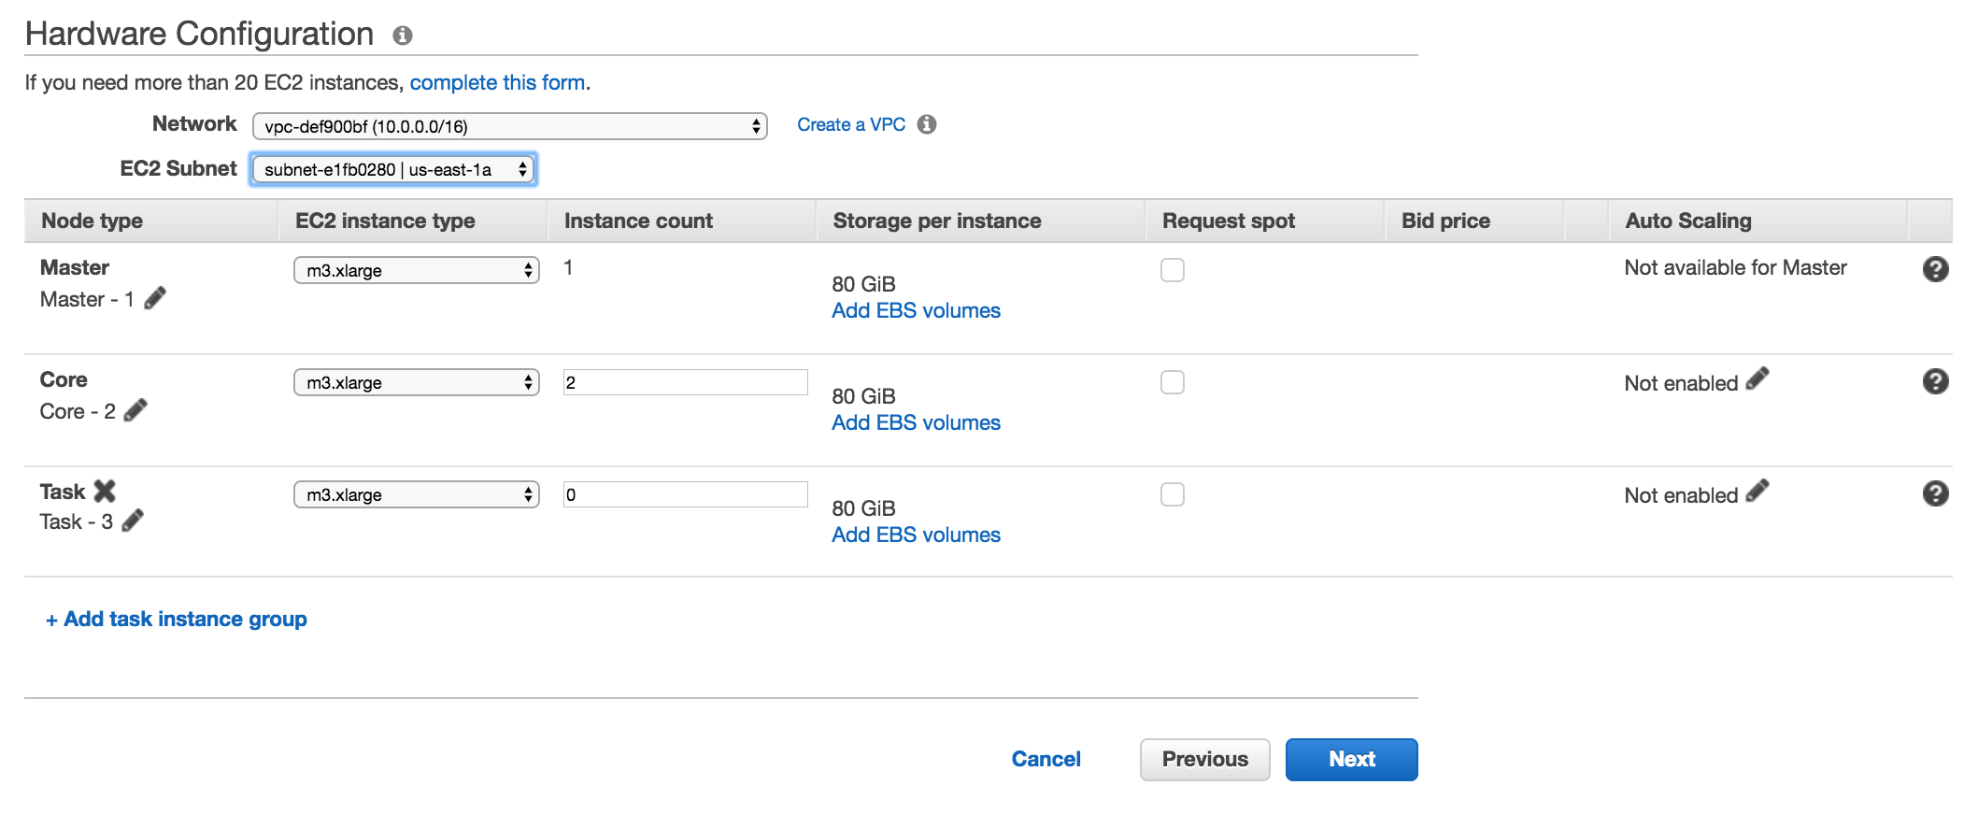
Networking - VPC
Node types
Instance types
Instance count

Slide 16
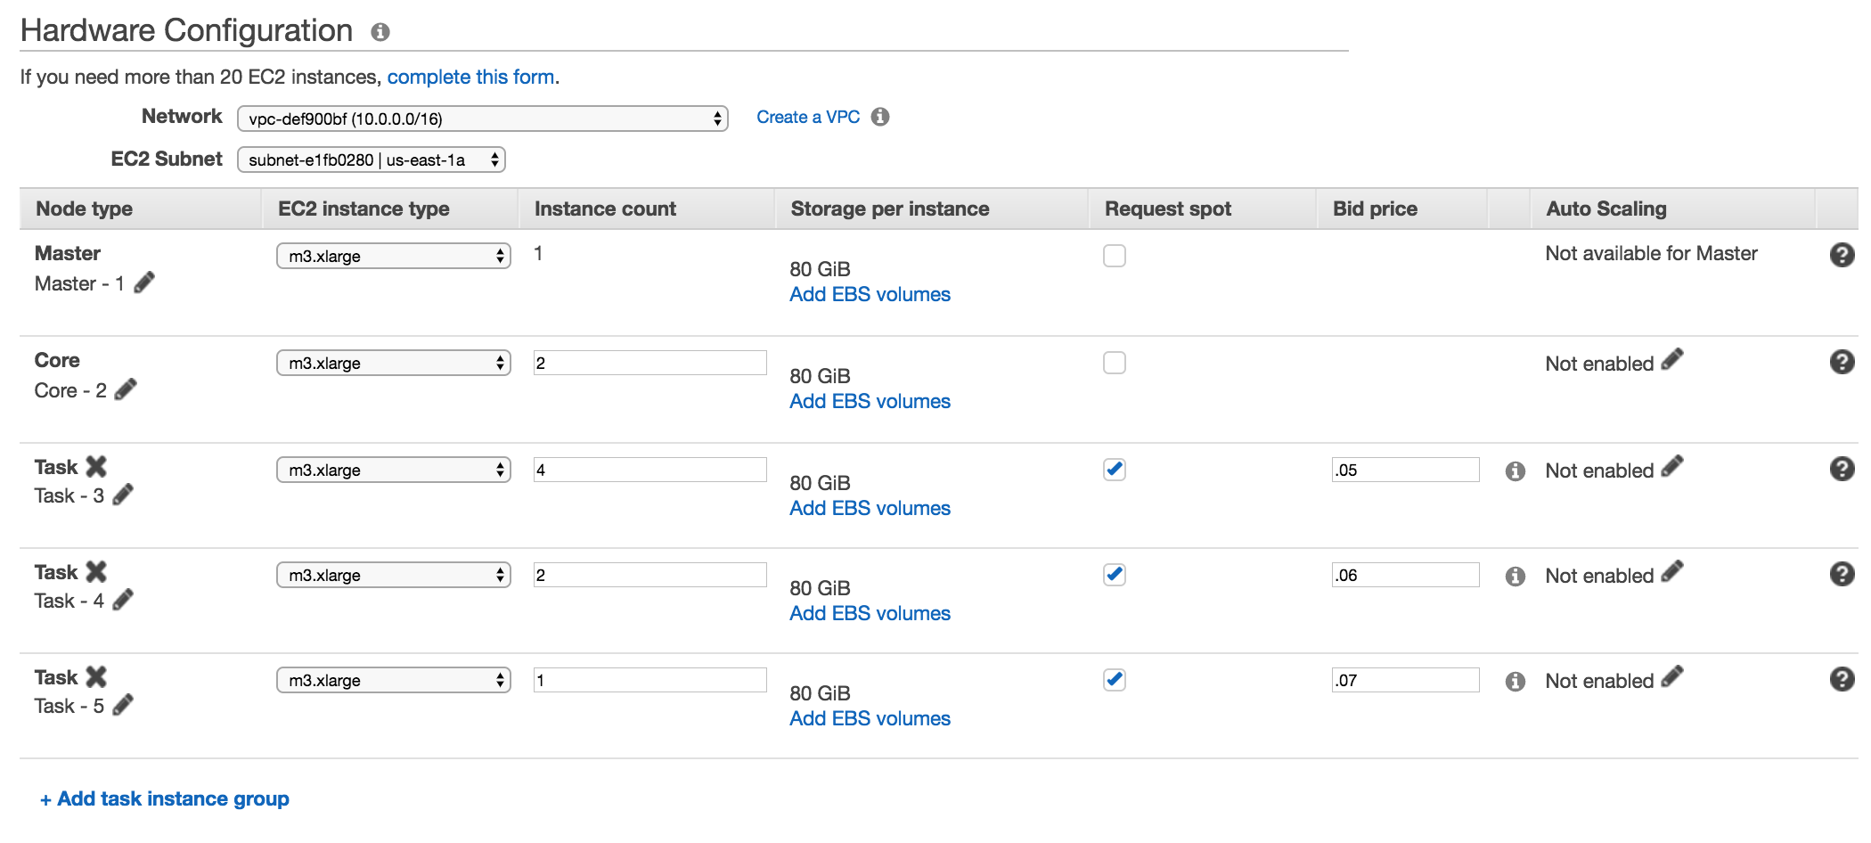
Request spot
Bid price

Slide 17
Hardware Configuration – Multiple Task Groups
EMR cluster
Master instance group
.07c
.06c
.05c
.05c
HDFS
HDFS
.07c
.06c
.05c
.05c
Core instance group
Task instance groups

Slide 18
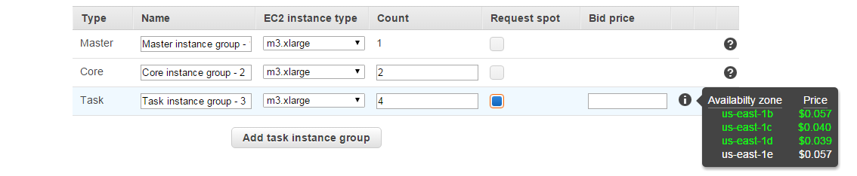
Spot Integration
aws emr create-cluster
--name "Spot cluster"
--release-label emr-5.14.0
--instance-groups InstanceGroupType=MASTER,InstanceType=m3.xlarge,InstanceCount=1 InstanceGroupType=CORE,BidPrice=0.03,InstanceType=m3.xlarge,InstanceCount=2 InstanceGroupType=TASK,BidPrice=0.10,InstanceType=m3.xlarge,InstanceCount=3

Slide 19
Auto Scaling
Storage

Slide 20
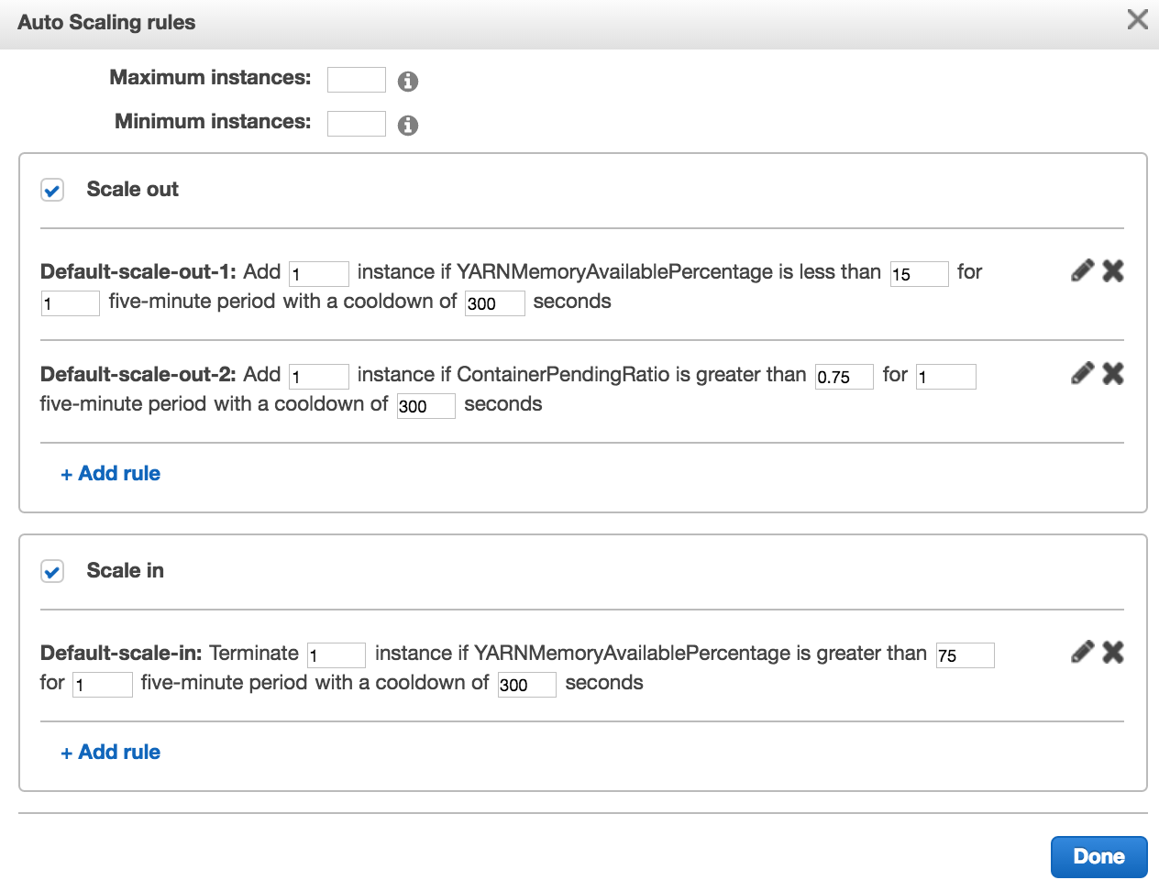

Slide 21
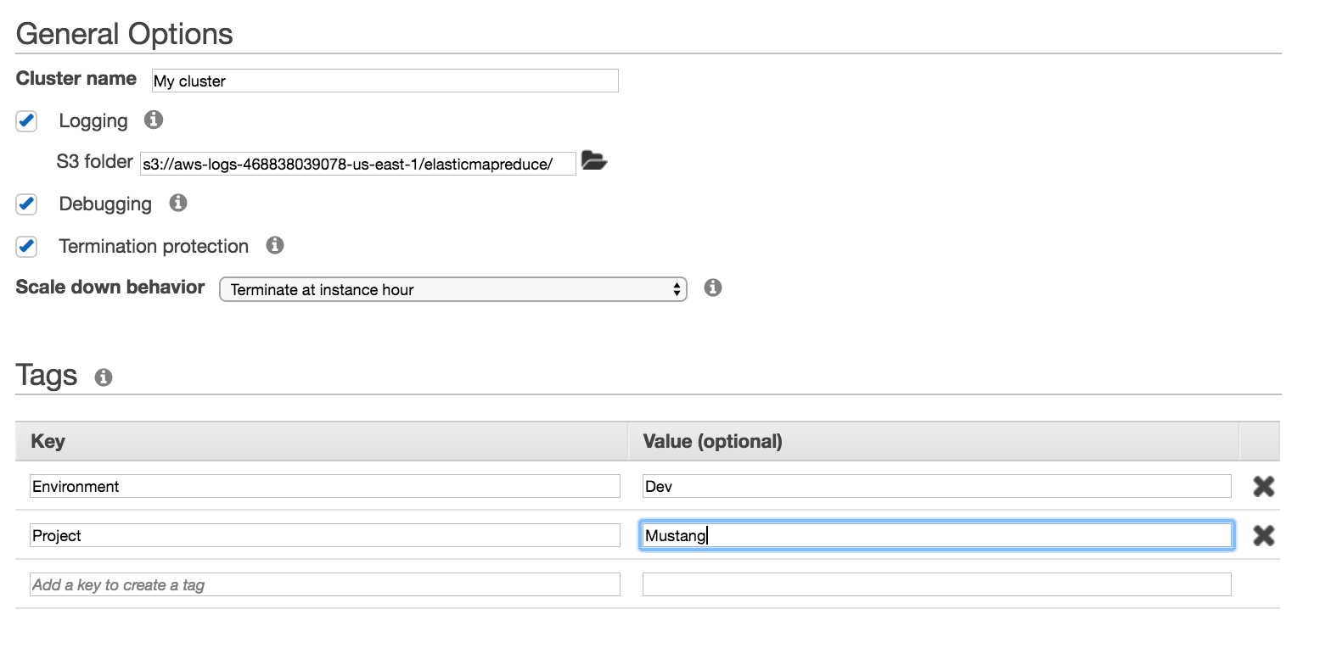
General options and Tags

Slide 22
General options - Logging
By default, logs written to master node - /mnt/var/log
Step Logs
Hadoop and YARN component logs
Bootstrap Action logs
Instance State logs
If Logging box is checked, logs are also written to S3
5 minute intervals
On by default for console
Off by default for CLI

Slide 23
General options - Debugging
EMR will index the logs in S3
Makes them available in the console

Slide 24
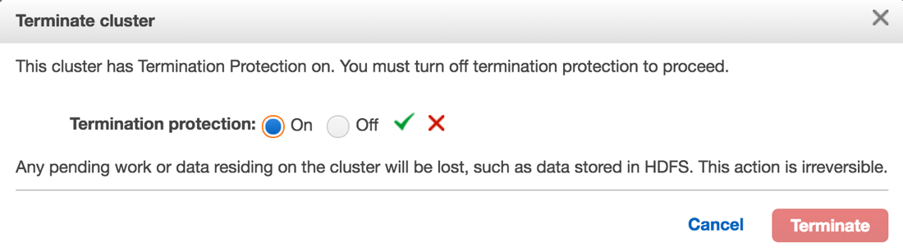
General options – Termination Protection
Prevents accidental termination of the cluster
On by default in Console
Off by default for CLI

Slide 25
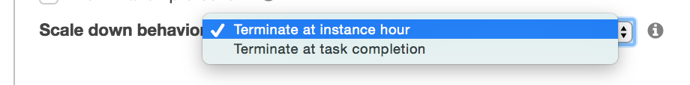
Scale Down Behavior

Slide 26
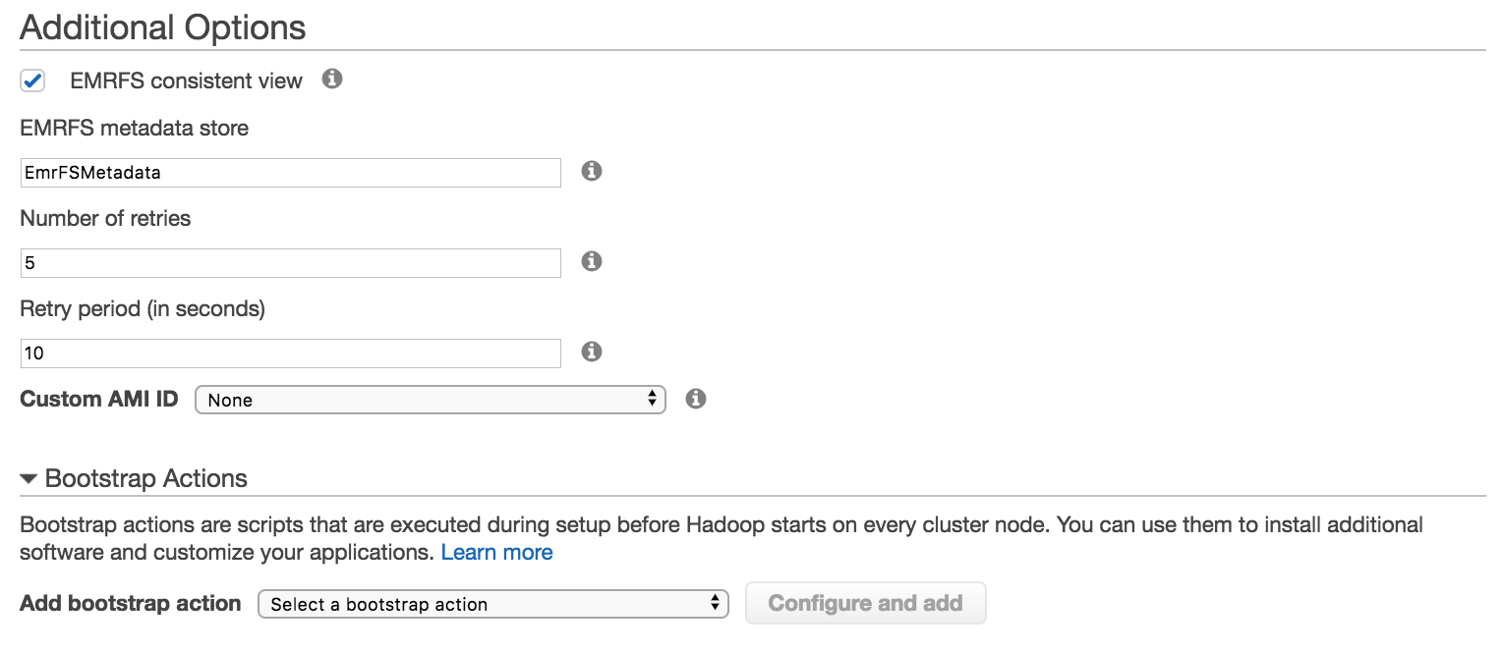
Additional Options

Slide 27
Additional Options – EMRFS Consistent View
S3 is eventually consistent
EMRFS consistent view:
Uses DynamoDB as a file registry
Ensures files created by a step are available to subsequent steps
You can configure:
Number of times EMFRS calls S3 after finding inconsistency
Amount of time until first retry

Slide 28
Additional Options – Custom AMI
Benefits
Reduction of cluster start time
Prevent unexpected bootstrap action failures
Support for Amazon EBS root volume encryption
Requirements
Must be an Amazon Linux AMI
Must be an HVM and an EBS-backed AMI
Must be a 64-bit AMI
Must not have users with the same name as applications (example: hadoop, hdfs, yarn, or spark)

Slide 29
Additional Options – Bootstrap Actions (BA)
Scripts executed before Hadoop starts on each node
Typically used for installing additional software
Can run up to 16 BAs
Run If
Conditional on an instance-specific value found in the instance.json or job-flow.json i.e. IsMaster=true
Custom
Run custom script. i.e. Copy a file from S3 to each node

Slide 30
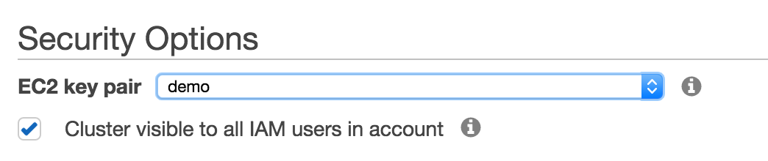
Security Options– EC2 key pair & visibility
EC2 key pair
Need to attach key pair to be able to SSH into Master node
Cluster visible
If unchecked, only creator can see Cluster in CLI and Console

Slide 31
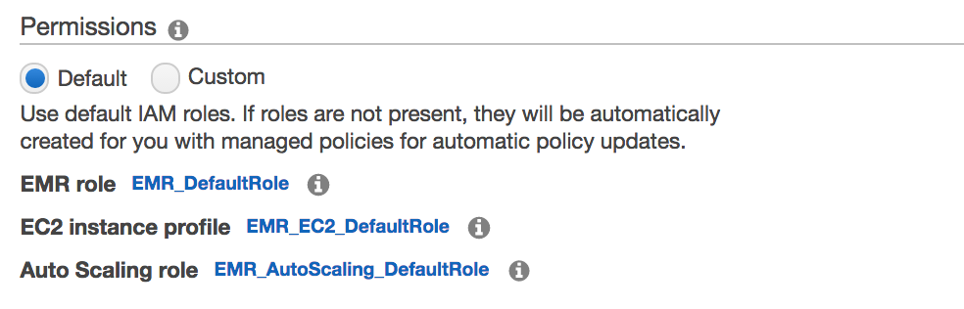
Security Options– Permissions

Slide 32
Security options - Permissions
EMR uses Roles to access AWS resources
EMR Role
Allows EMR to access resources such as EC2
EC2 Instance Profile
Allows EC2 instances in cluster to access resources such as S3
Auto Scaling Role
Allows Auto Scaling to add and terminate instances
Can use default or choose your own.

Slide 33
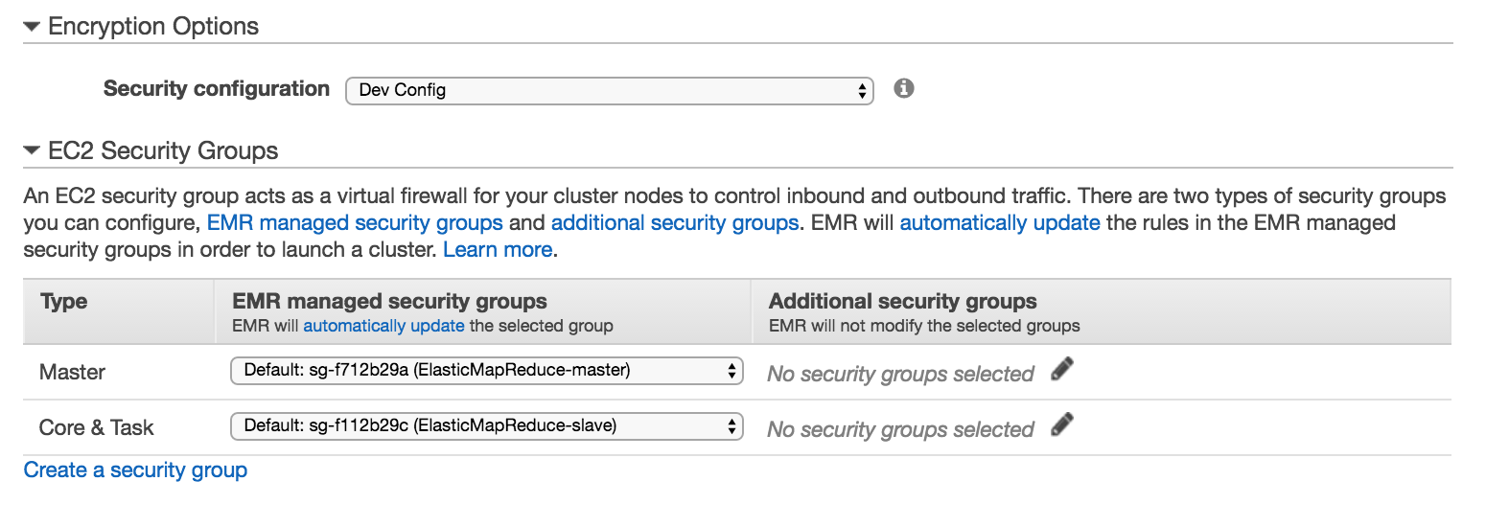
Security options – Encryption & Security Groups

Slide 34
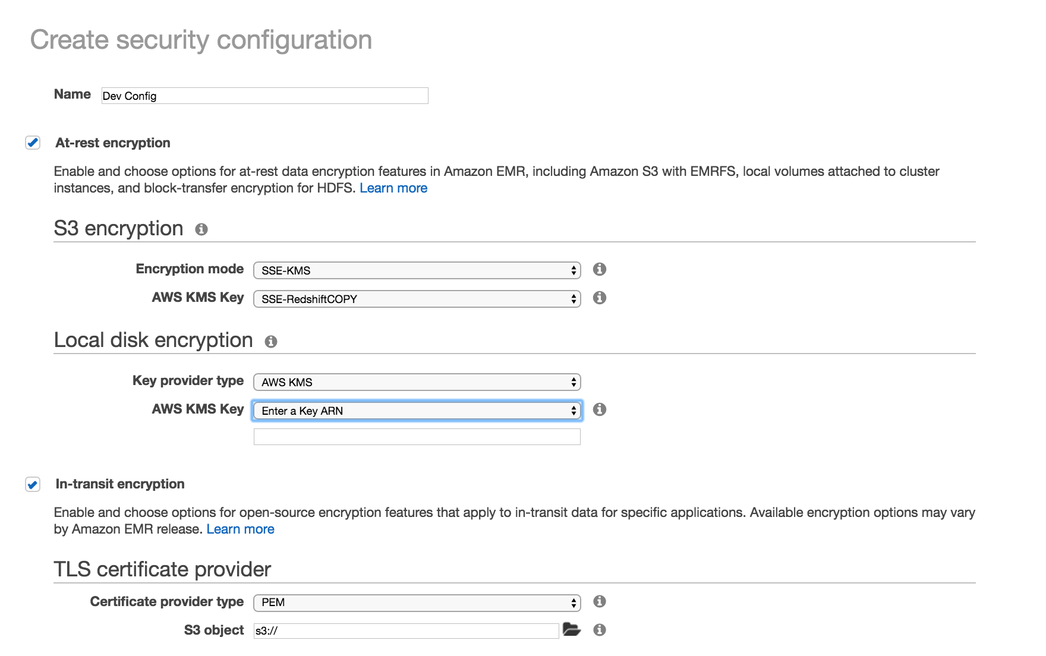
Needs to be created before you start cluster creation

Slide 35
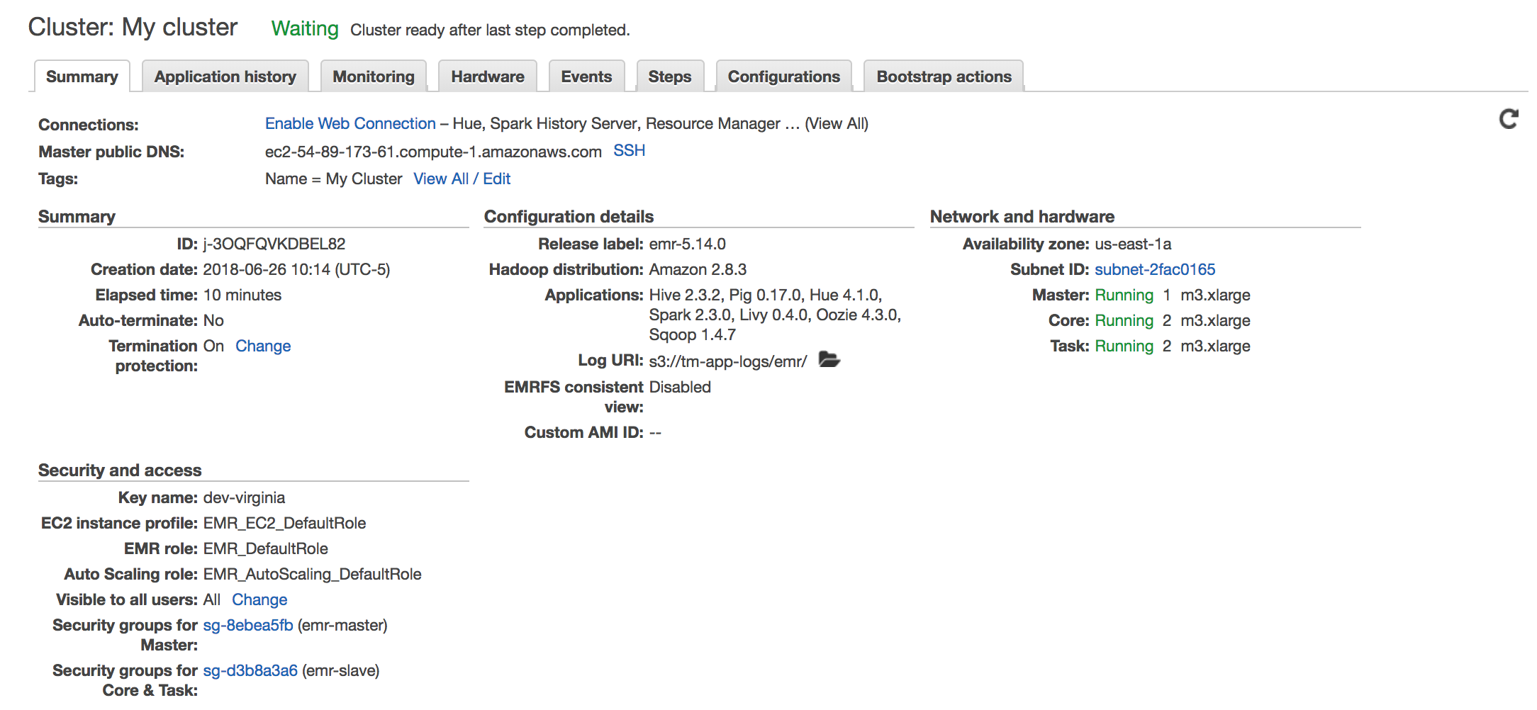
Cluster Details

Slide 36
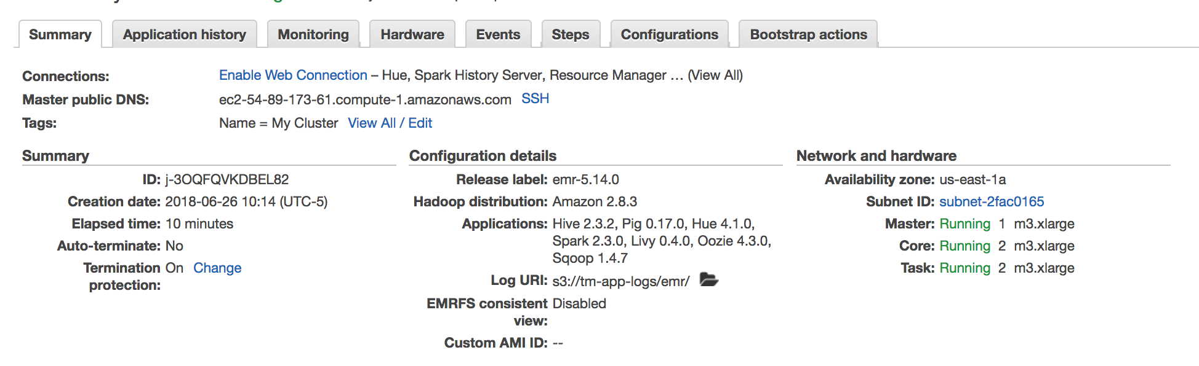
Cluster Details
Master Node DNS

Slide 37
Cluster Details
Information about the software you are running, logs and features

Slide 38
Cluster Details
Infrastructure for this cluster

Slide 39
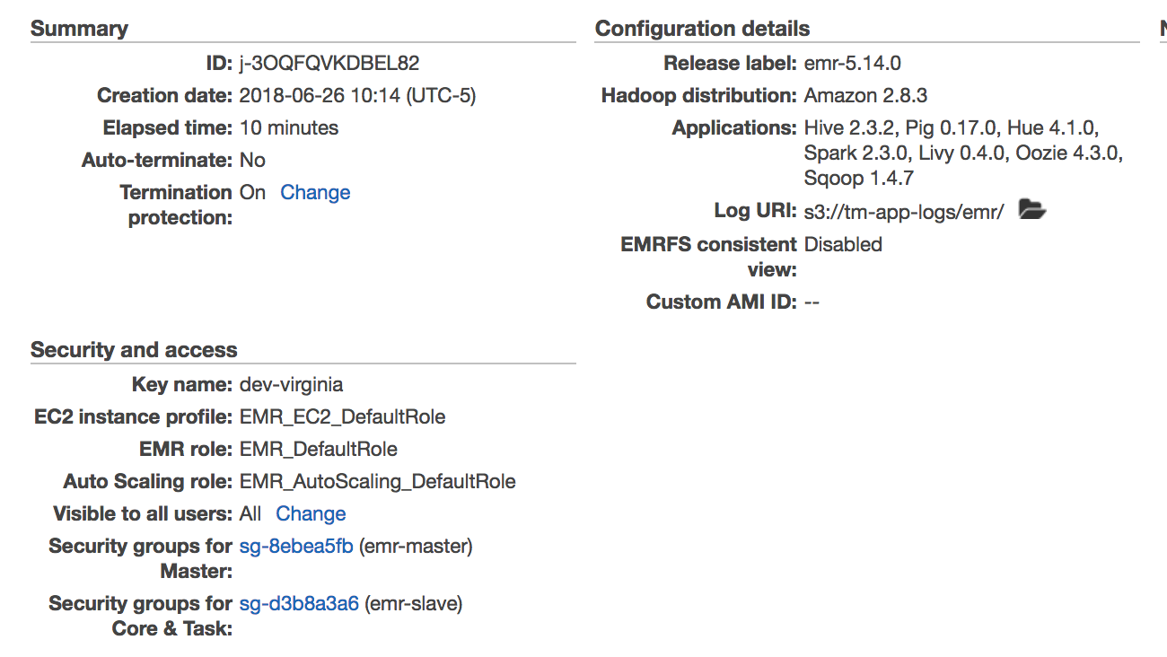
Cluster Details
Security Groups and Roles

